Slide 1

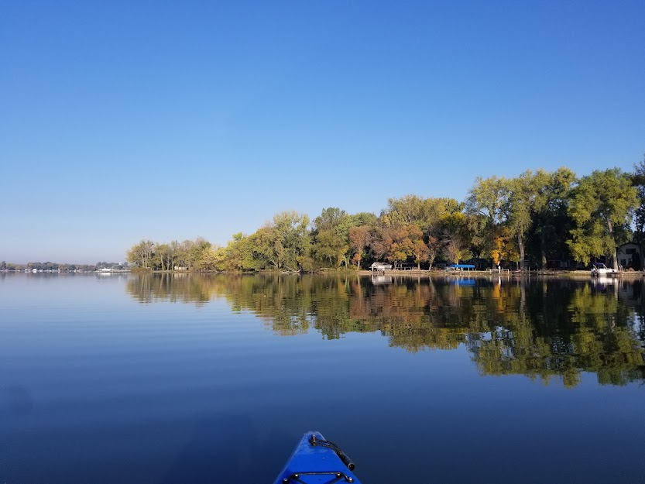
Welcome
2026
Waterville Lakes Association Annual Public Meeting

Slide 2

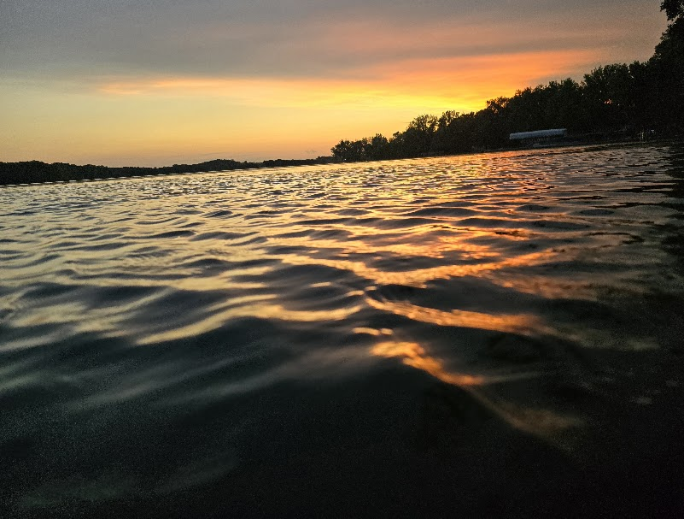

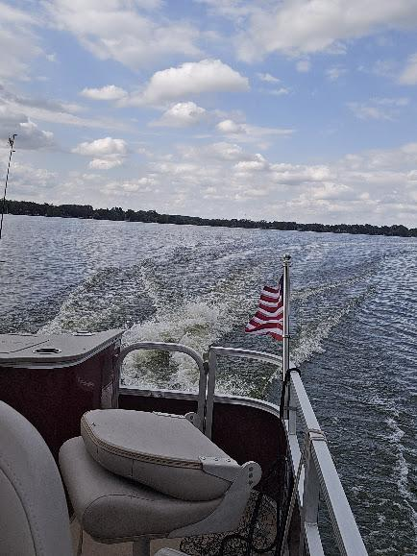

Slide 3
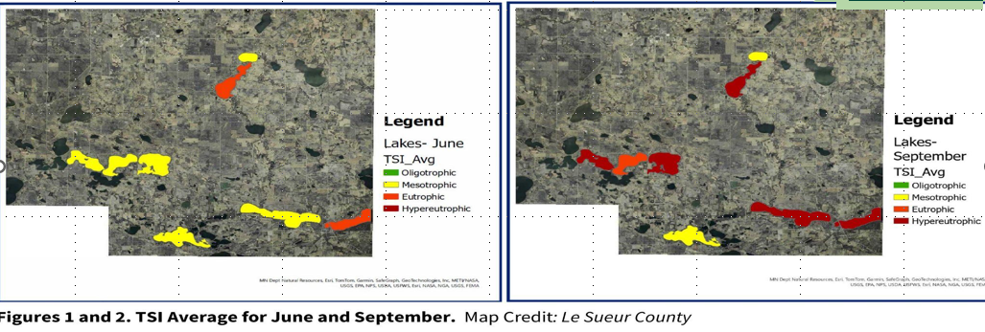
Water Sampling Volunteers
Collect samples weekly
Deliver to Le Sueur County
Results shared at end of season
LeSueur County Offers
Water Sampling Program
Water Sampling Volunteers
Gary Schott
Phil Langerud
THANK YOU

Slide 4
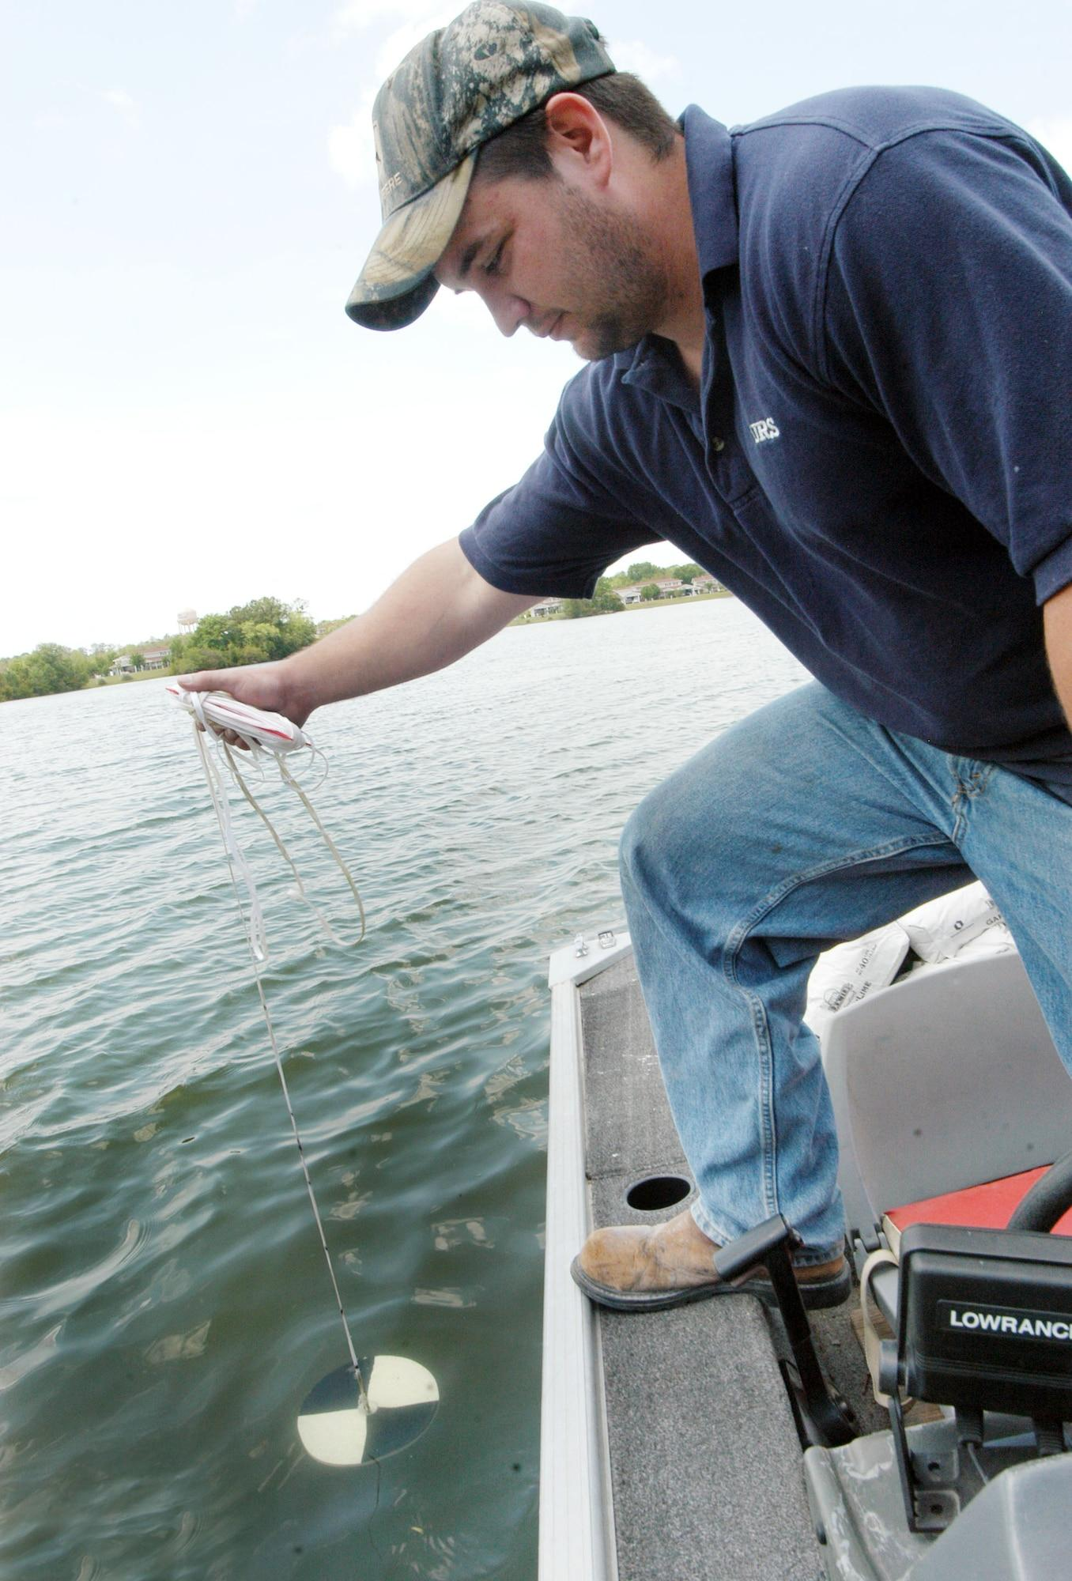
Secchi
Disk Reading
Tracking water clarity, for the over health of the lake.
Secchi Disk Volunteers
Weekly clarity readings
Data submitted to MPCA
Helps track algae and nutrient levels
Secchi Disk Volunteers
Chuck Birtz
Gary Schott
Andrea Berg

Slide 5

Lake Water Levels
Volunteer Neal Cronin
Reports to DNR

Slide 6
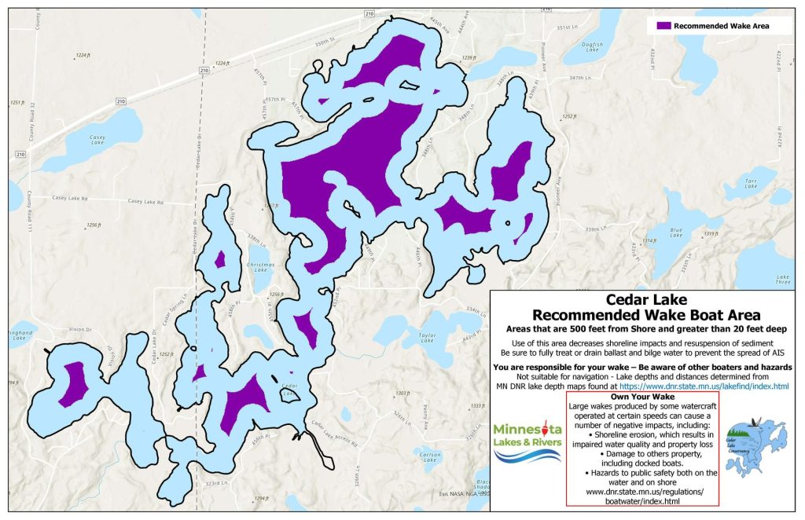
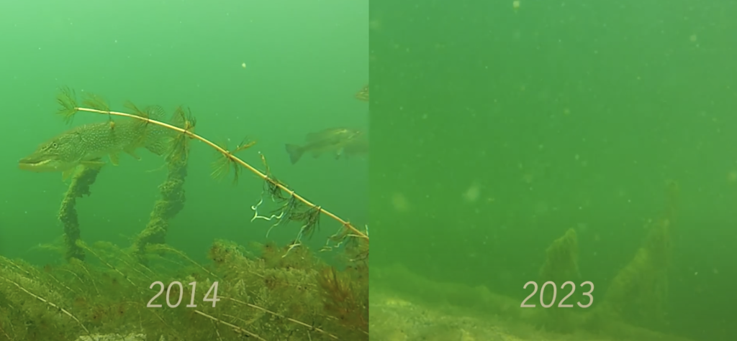
Wake-Safe Map
Wake Boat Mapping for
Tetonka and Sakatah.
They will be posted at
Boat Landing
Wake boat wakes are harmful to ecosystems because they produce 6–12 times more
energy than standard boats, creating
massive waves that cause severe
shoreline erosion, destroy shallow-water habitats, and stir up bottom sediments. This turbulence releases phosphorus, fueling toxic algae blooms, reduces water clarity and spreads invasive species via ballast tanks.

Slide 7


Slide 8

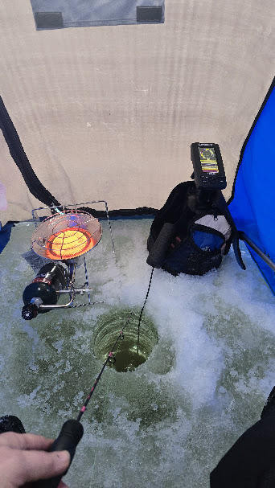
Grant Funding Challenges
WLA we are always looking for Grants to apply for to better our Lake, environment and community.
DNR Grants for AIS change to a lottery chance on getting selected, unfortunately we have not received the $5000 grant for three years.
Keep it Clean is an awareness of winter pollutants during the ice fishing months. Unfortunately were not selected for 2500.
Many Grants ask for a 50% Match

Slide 9

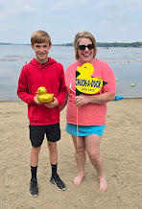
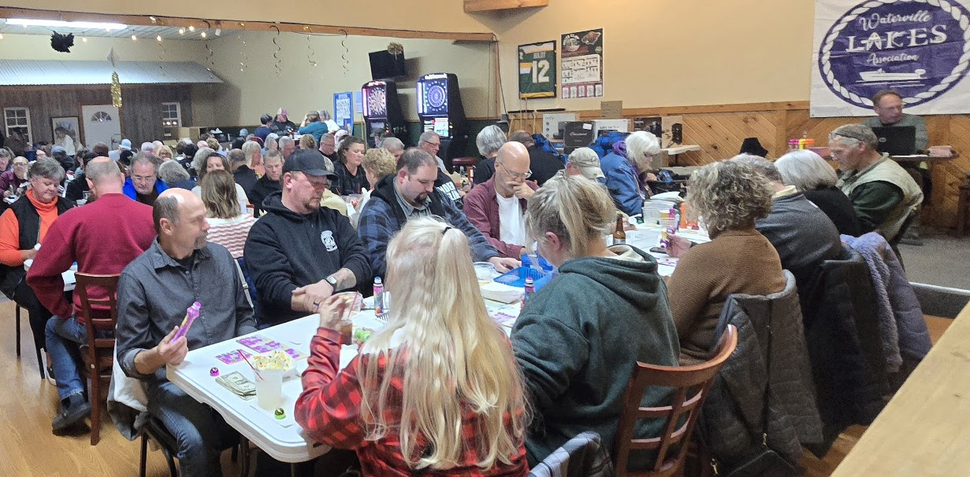
Fundraising
Efforts
For AIS
Prevention
CHUCK-A-DUCK
Bullhead Days
Memberships
Donations
Grants
Host Spring/Fall Bingo
Chuck-A-Duck
Sell Bingo Card-Lions Club

Slide 10


Volunteer to sell BINGO cards at Corner Bar Wednesday evenings 6:50-9:00pm
https://www.signupgenius.com/go/10C0C4CAFA92FAAFCC34-55026590-waterville
Sign up online
Each Wednesday April through October we need 3 volunteers to help sell Lions Club BINGO cards. In return, the Lions Club makes a $250 donation to the WLA each week. This is HUGE Fundraiser for the association and it’s a fun way to help out. Bring your friends and make a night of it!
The Corner Bar generously offers our volunteers a bonus incentive. For Volunteering you will receive one FREE MEAL and two FREE DRINKS each Wednesday!

Slide 11


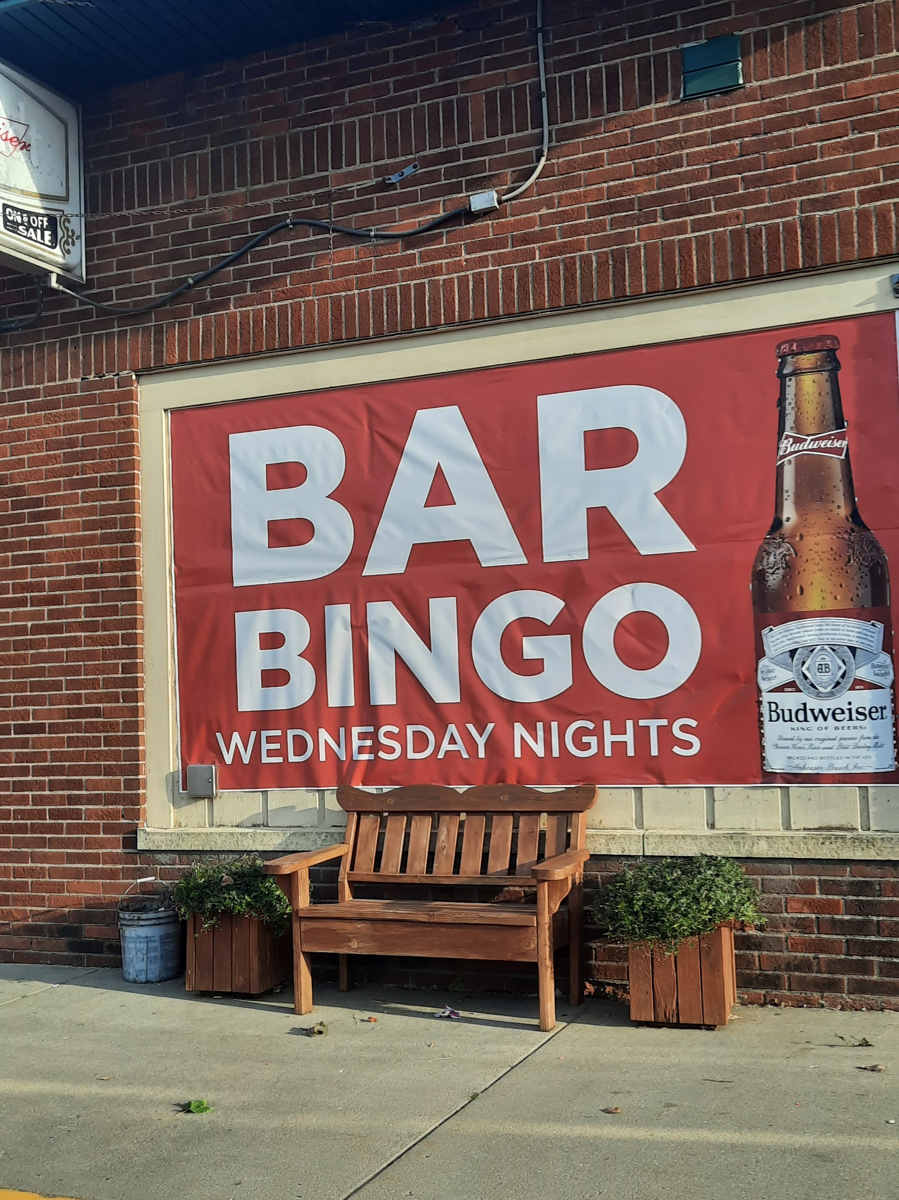


JOIN SMALL VOLUNTEER COMMITTEE
A little time
Your Talents
And a lot of FUN
Can make a HUGE difference
Cannon River Shed
Clean Up

Slide 12

BECOME A MEMBER OF THE WLA
BOARD OF DIRECTORS!!
BOARD OFFICERS:
President
Vice President
Secretary
Treasurer
BOARD MEMBERS
Five Required Board Members
Six Optional Additional Voting Board Members
Two Associate Members (Non-Voting)
Three-Year Terms - Up for vote this year
Secretary
Two Required Members
Two Optional Additional Members

Slide 13
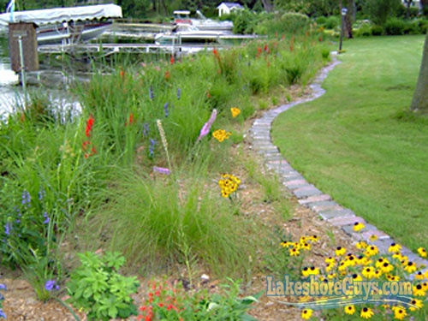



As a responsible Lake steward ensure that the transition from land to water remains a living, breathing ecosystem. By prioritizing deep-rooted native plants over
manicured lawns, we can stop runoff, feed our local pollinators, and keep the water clear for generations to come.
Buffer Zone

Slide 14
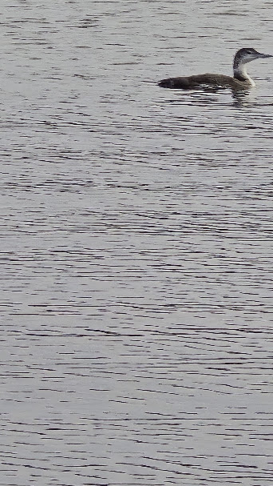
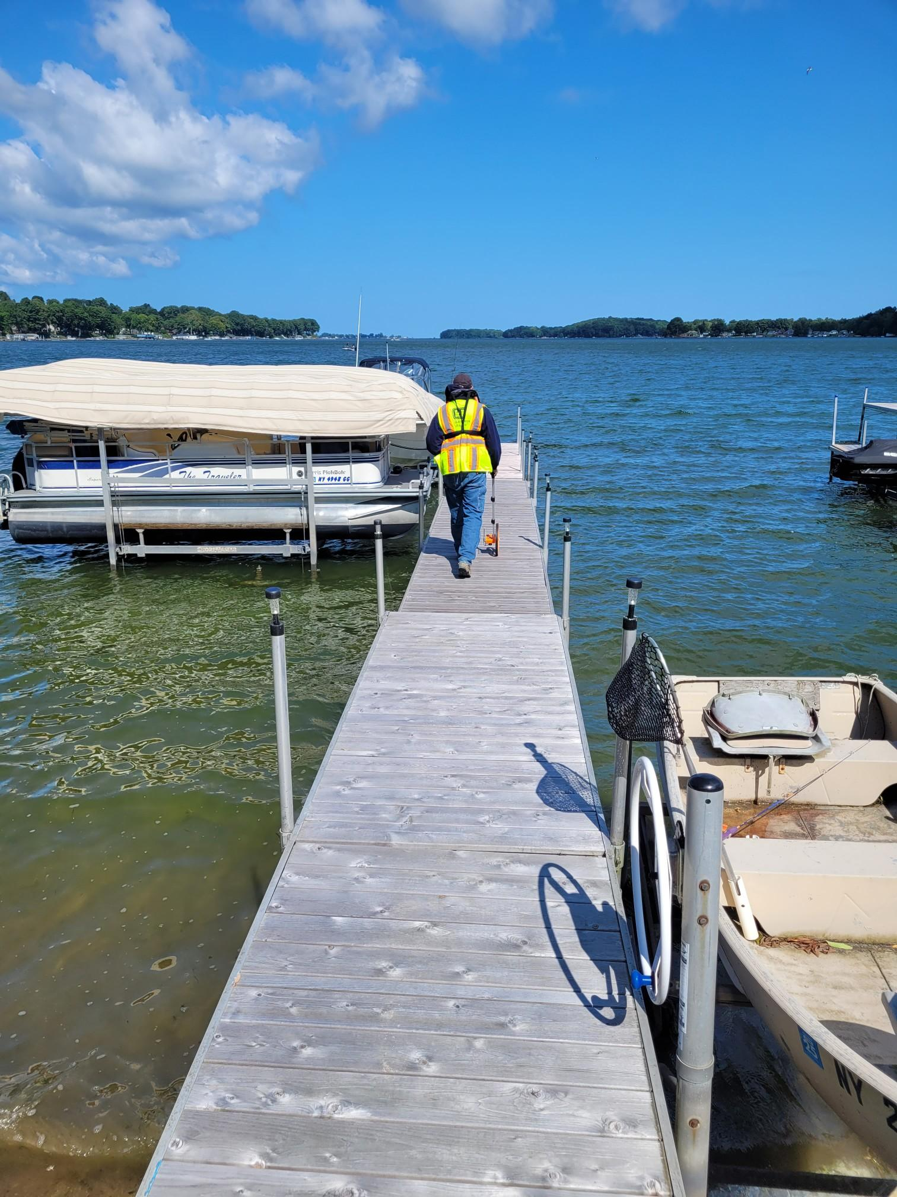
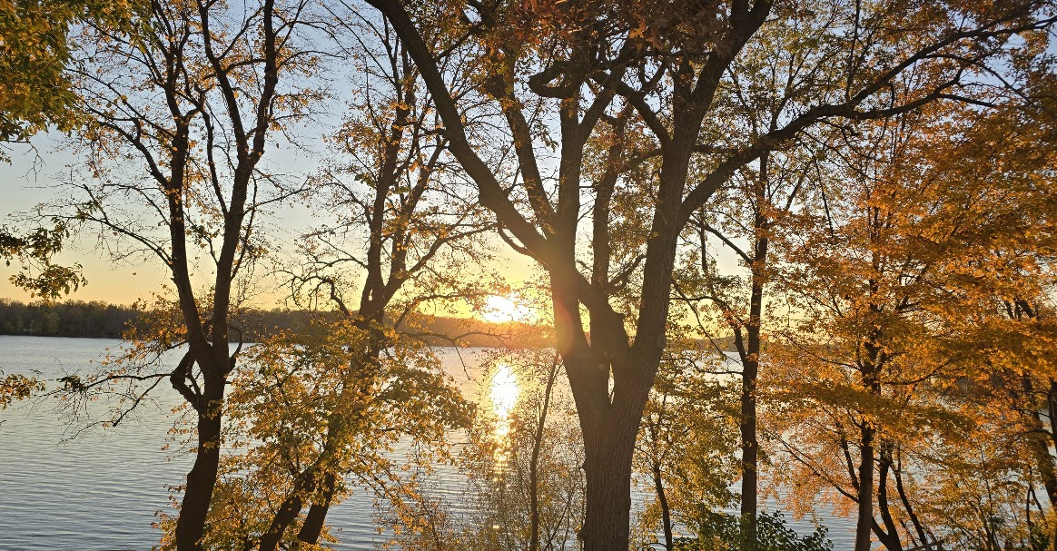
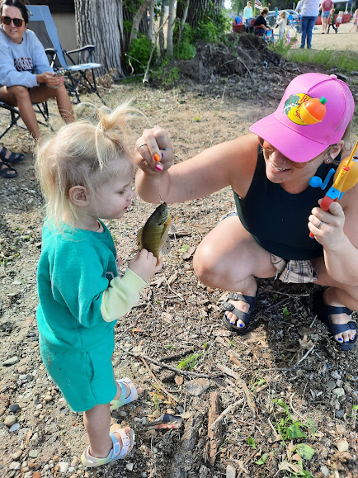
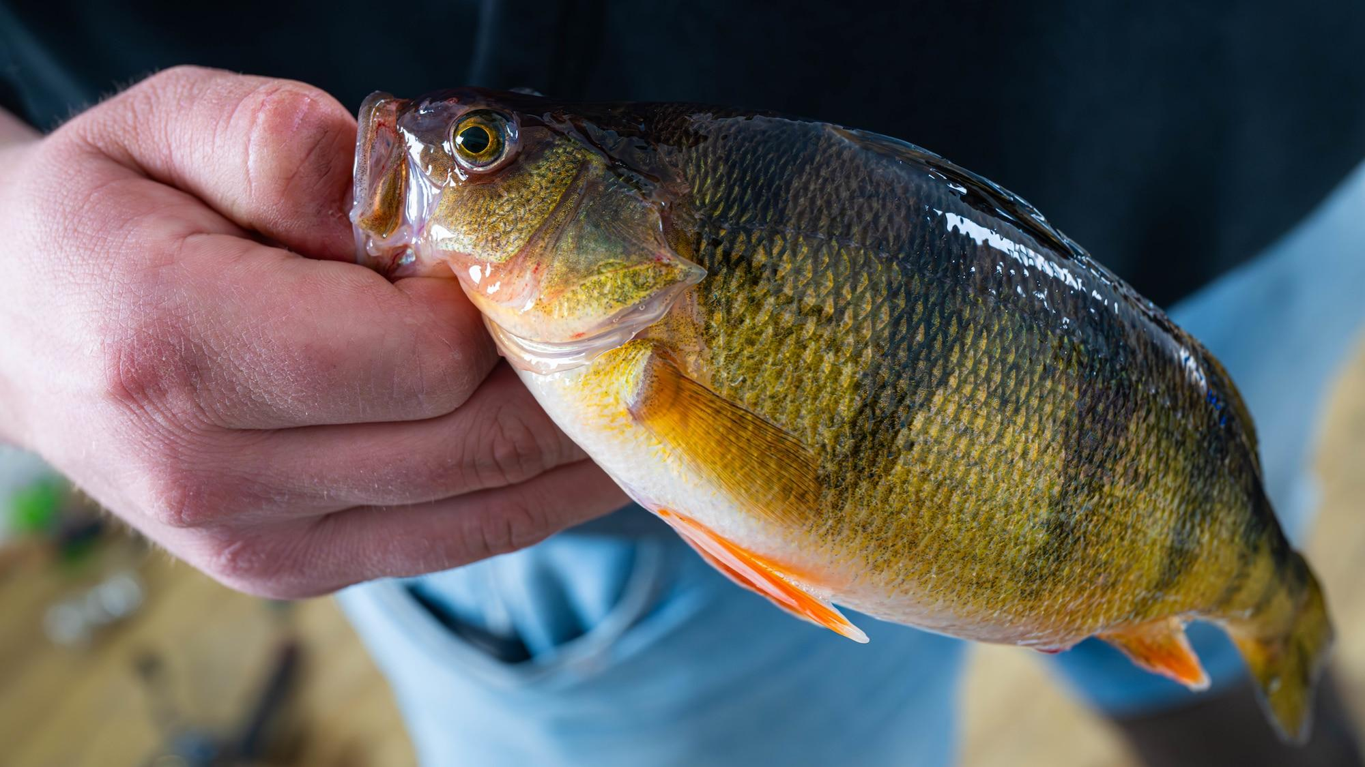
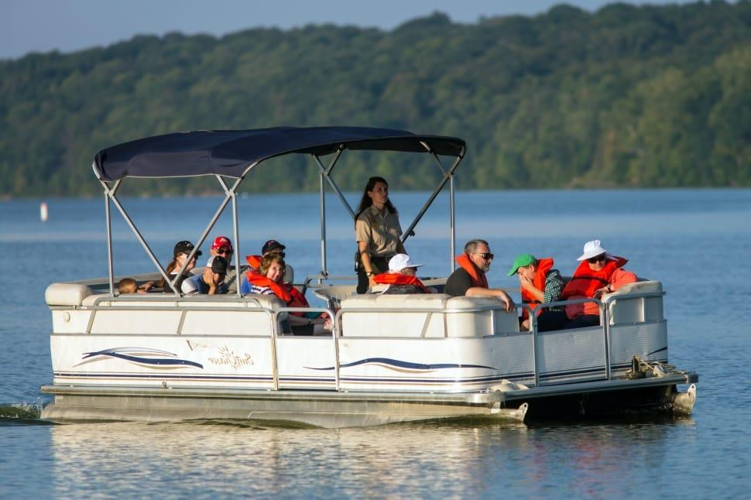
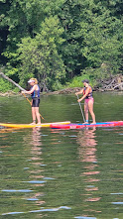

Thank You for your time today!
Here's to a safe, sunny, and unforgettable summer 2026.
See you out on the water.

